Slide 1
Automobile Customer Segmentation: Unsupervised Machine Learning Investigation
Deirdre Boland
21 Feb 25

Slide 2
Dataset, Objective and Approach
Dataset
Sales team at an automobile company has classified all customers into 4 segments (A, B, C, D ). A strategy of performing segmented outreach and communication has worked exceptionally well for them.
Objective
Can an unsupervised machine learning (ML) model predict the 4 segments?
or
Is domain knowledge and further data required?
Approach
Took training dataset and removed A-D segmentation to review against unsupervised ML results
Reference – Kaggle: Customer Segmentation Vetrivel-PS

Slide 3
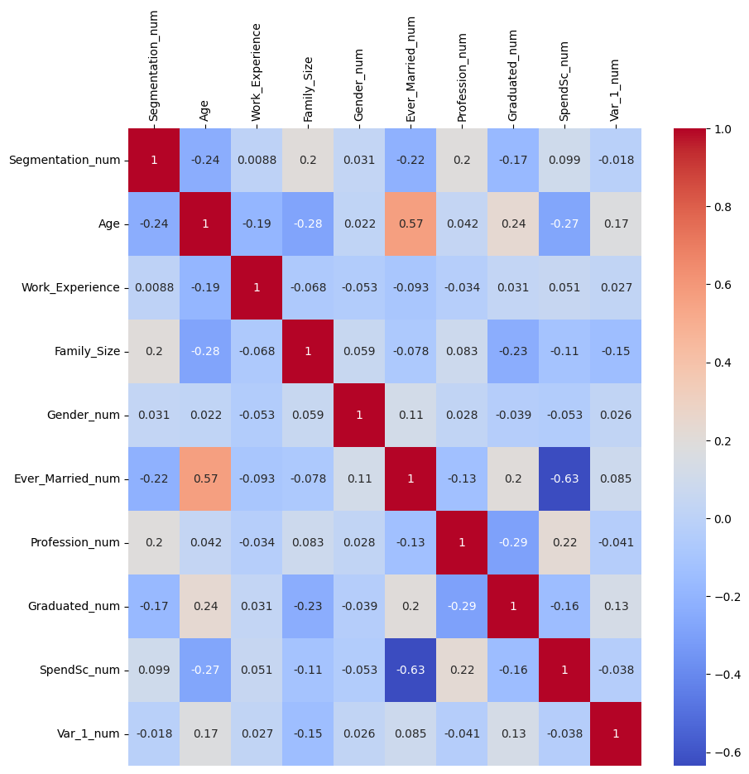
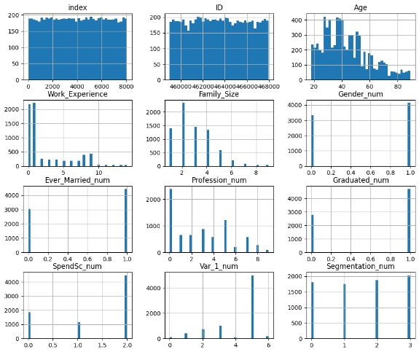
Data exploration and cleaning
Only ID, gender, age, spending score and segmentation have full data
Removed null values from Ever Married (cat), Graduated (cat), Family Size (num), Var_1 (cat)
7.3% data dropped – 7477 from 8068 (index = original dataset row index)
If not removed or replaced with string values will create new variable on encoding
Label encoded categorical features
Gender - male = 1, female = 0
Ever married and Graduated - yes = 1, no = 0
Profession - Artist = 0, Doctor = 1, Engineer = 2, Entertainment = 3, Executive = 4, Healthcare = 5, Homemaker = 6, Lawyer = 7, Marketing = 8, null= 9 *
*Potential loss further 1.2% if dropped null, categories seemed limited so allowing place for other/null
Spend score - Average = 0, high = 1, low = 2
Low has highest count not average – average may be based on external factor
Var_1 - Cat 1 - 7, 0-6
Segmentation - A-D, 0-3
Work experience further 10% loss if dropped nulls
High count 0/1s despite wide adult age range
Low correlation
dropped column from dataset

Slide 4
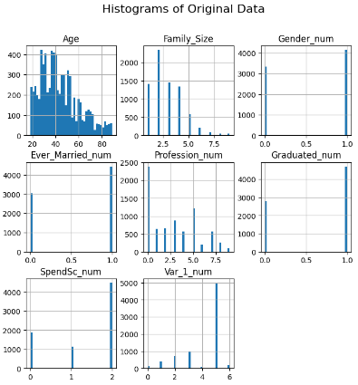
Modelling approach
8 numeric features after dropping segmentation (target)
Data preparation
Regularisation
Scaled by Z scale, Robust scale and Min max scale
Normalised by L1, L2 or Max normalisation
PCA of original, scaled and normalised
Unsupervised modelling
Forcing to 4 categories (k = 4) to match target set even if not optimal
K means (Km) clustering
Default settings, random state set to limit variation from setting initial centroids
K assessment using elbow method and silhouette score
Agglomerative (Aggl)/Hierarchical clustering
metric= "Euclidean", linkage = "ward”
Deterministic, random state not required
K assessment using silhouette score

Slide 5
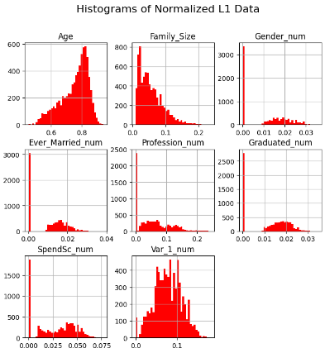
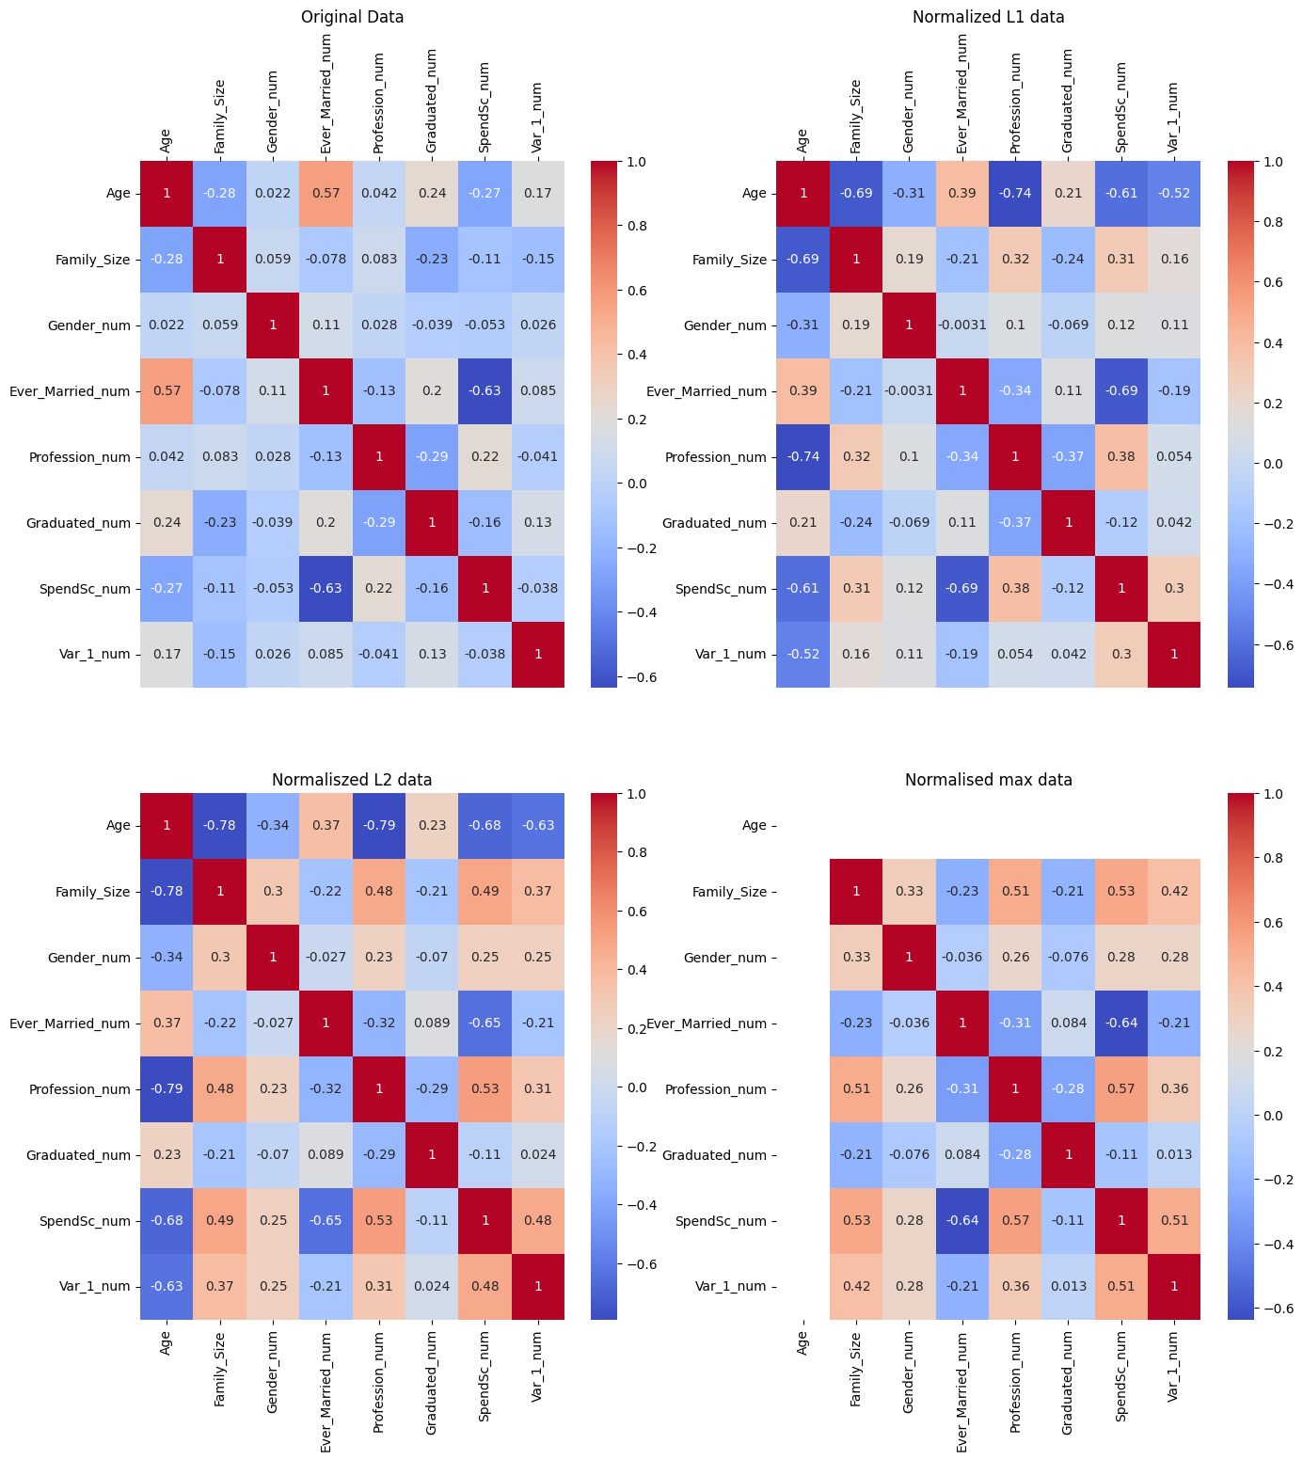
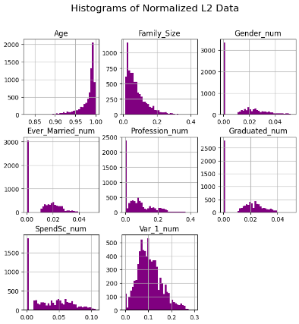
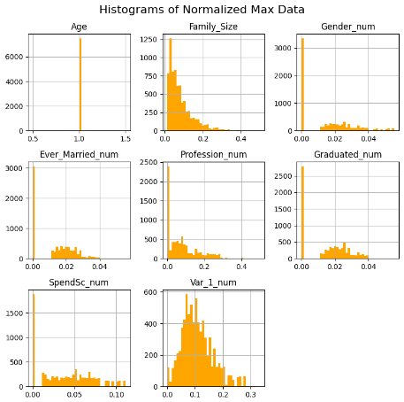
Effects of normalisation
Normalizer works on each sample (row) independently
calculates the norm of each sample and then scales the individual features by dividing them by the computed norm.
A regularization method, e.g. a method to keep the coefficients of the model small, and in turn, the model less complex.
L1 Norm: aka Manhattan norm - sum of absolute values
L2 Norm: aka Euclidean norm - square root of the sum of squared values – most common
Max Norm: Scales each feature by the maximum absolute value in the sample – used neural network weights
References - https://www.pythonprog.com/sklearn-preprocessing-normalizer/#:~:text=The%20Normalizer%20in%20Scikit-Learn%20focuses%20on%20transforming%20individual,values%20so%20they%20fall%20within%20a%20certain%20range. https://machinelearningmastery.com/vector-norms-machine-learning/

Slide 6
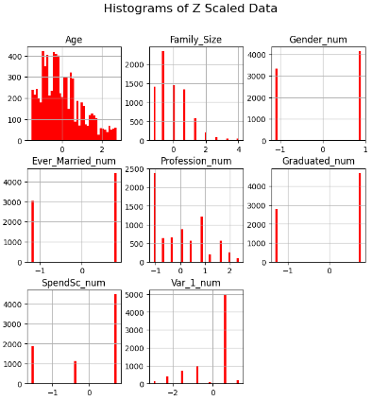
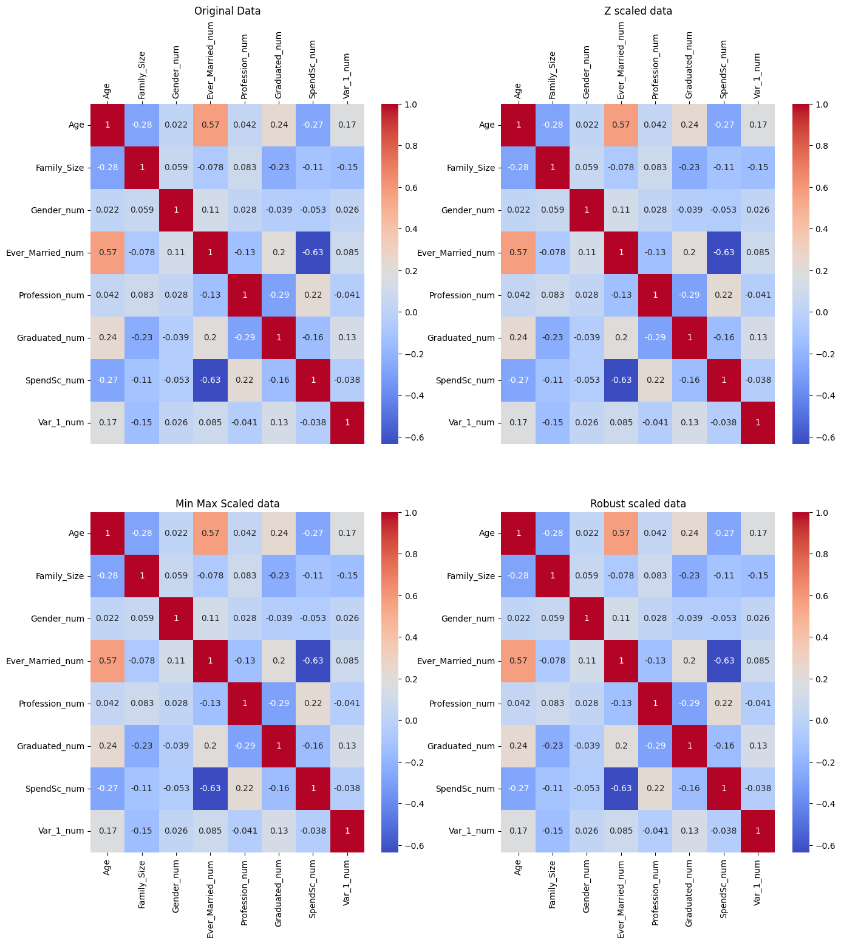
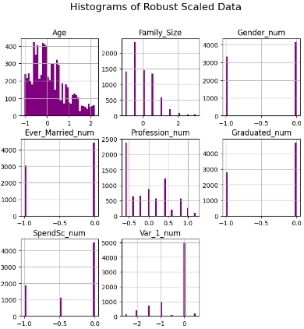
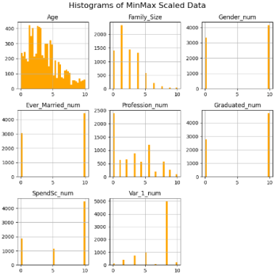
Effects of scaling
X axis changes but no major change to distribution or correlation

Slide 7
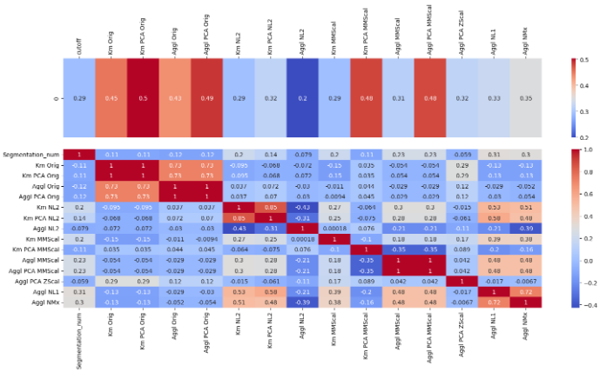

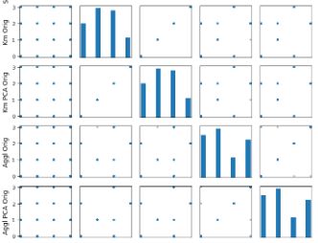
Results – 8 features
Correlation matrix – target vs. models
Silhouette score
Original data Variance Ratio: [0.958 0.024] 2 component PCA covers 98.17 %
L2 normalised data Variance Ratio: [0.62 0.18 0.128] 3 component PCA covers 93.35 %
Min max Scaled data Varaiance Ratio: [0.35 0.226 0.182] 3 component PCA covers 75.82 %
Z Scaled data Varaiance Ratio: [0.28 0.168 0.145] 3 component PCA covers 59.47 %
L1 normalised data Varaiance Ratio: [0.778 0.112 0.069] 3 component PCA covers 95.86 %
Max normalised data Varaiance Ratio: [0.635 0.179 0.125] 3 component PCA covers 93.89 %
Scatter matrix - target vs. models
- minimal alignment
Desired scatter matrix output is 4/minimum points only on scatter as per Km Orig vs. Km PCA orig (on right)
Actual outcome = a 0 in segmentation has a 0,1,2 or 3 in model and same for all categories

Slide 8
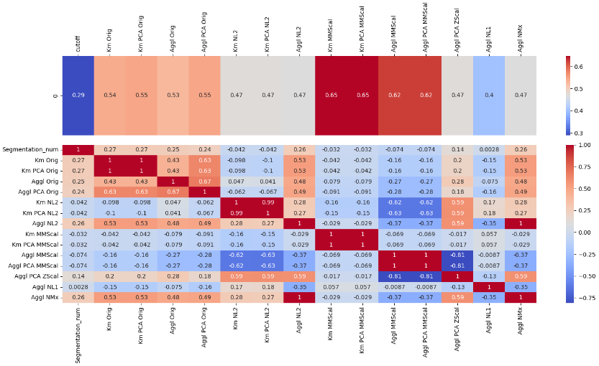
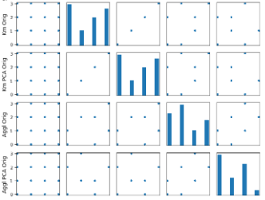
Results – 3 features
Only ID, gender, age, spending score and segmentation have full data – questions around spending score and profession
Copied notebook, remodelled data for just gender, age and spending score and re-ran
Correlation matrix – target vs. models
Silhouette score
Original data Variance Ratio: [0.99673525 0.00238464]
2 component PCA covers 99.91 %
L2 normalised data Variance Ratio: [0.82 0.18] 2 component PCA covers 99.98 %
Min max Scaled data Variance Ratio: [0.52 0.38 0.10] Variance covered by 3 component PCA covers 100.0 %
Z Scaled data Variance Ratio: [0.43 0.33 0.24] 3 component PCA covers 100.0 %
L1 normalised data Variance Ratio: [0.89 0.11] 2 component PCA covers 100.0 %
Max normalised data Variance Ratio: [0.82 0.175] 2 component PCA covers 100.0 %
Scatter matrix - target vs. models
- minimal alignment
Desired scatter matrix output is 4/minimum points only on scatter as per Km Orig vs. Km PCA orig (on right)
Actual outcome = a 0 in segmentation has a 0,1,2 or 3 in model and same for all categories

Slide 9
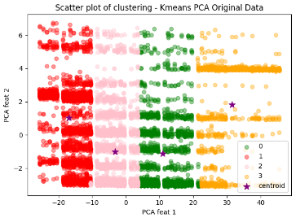
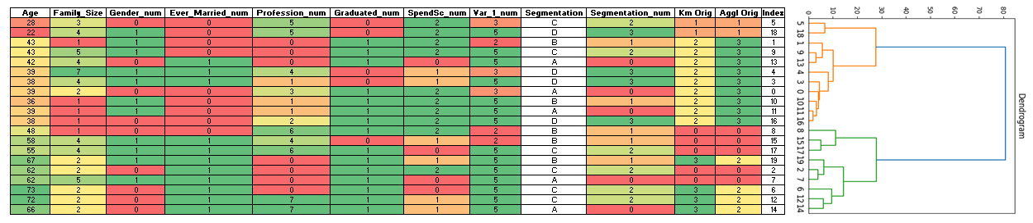
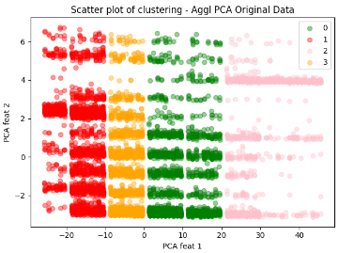
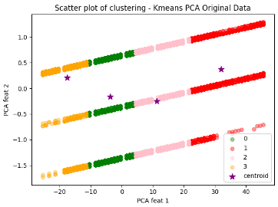
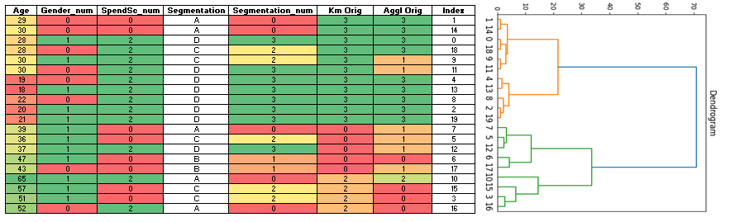
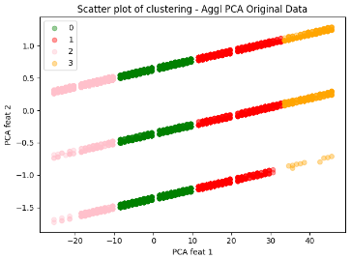
Cluster visualisation
Kmeans (Km) and Agglomerative (Aggl) scatter plots of data use whole dataset
20 row subset (fixed sampling using numpy seed) used to plot dendrograms (dend)
rough idea of categorisation compared to full data
8 features – Age tracks & Aggl and Kmeans close to dend (2 and 3 swapped)
_______________________________________________________________________________________________________
3 features – Age tracks & Kmeans matches and Aggl close to dend
Original data Variance Ratio: [0.95767885 0.02400603]
Variance by 2 component PCA covers 98.17 %
Original data Variance Ratio: [0.99673525 0.00238464]
Variance by 2 component PCA covers 99.91 %

Slide 10
Conclusion
Unsupervised learning was not able to reproduce existing A-D customer classification
More domain knowledge required – oddities in work experience and spending score noted in data exploration
Future work/improvements
Could have split dataset into training and test data with known answer
Iterative approach taken – function or pipeline would reduce coding lines for review

